Slide 1

Exploratory Data Analysis on AMEO Dataset
Dusa Sai Krishna

Slide 2
About me
I am a fervent data science enthusiast, captivated by the intricacies of data analysis and machine learning. As an intern at Innomatics Research Labs, I immerse myself in real-world data challenges, driven by an insatiable curiosity to unravel the mysteries concealed within datasets. My journey is propelled by a dedication to honing my skills in problem-solving and analytical thinking, continuously expanding my expertise from fundamental algorithms to advanced machine learning techniques.
Within the dynamic environment of Innomatics Research Labs, I am fortunate to collaborate with like-minded professionals who share my passion for data science. Engaging in collaborative projects, I contribute my analytical prowess to tackle diverse challenges, steadily building a robust skill set in data preprocessing, statistical analysis, and predictive modeling. Each project enriches my understanding and propels me towards a fulfilling career in this ever-evolving field, fueling my quest for knowledge and growth.

Slide 3
Objectives
The main goals of this project revolve around delving into the AMEO dataset to extract valuable insights, particularly focusing on understanding the correlations between various attributes and the target variable, Salary. The specific aims include:
1. Analyzing each relevant column of the dataset individually to unveil patterns, distributions, and inherent characteristics through univariate analysis. This step aims to gain a deeper understanding of the dataset attributes on an individual basis.
2. Conducting bivariate analysis to explore the relationships between different attributes. By examining pairs of attributes, the objective is to comprehend how they correlate with each other and their potential impact on the target variable, Salary.
3. Identifying the attributes that have a significant influence on better compensation (Salary). Through thorough analysis, the aim is to pinpoint the key attributes that play a vital role in determining variations in salary levels.

Slide 4
Data Summary
The AMEO dataset, which stands for Aspiring Minds' Employment Outcomes 2015, provides a comprehensive overview of the employment landscape for engineering graduates in India. With the nation producing a remarkable 1.5 million engineers annually, comprehending the factors influencing salary and job opportunities becomes crucial. This dataset aims to shed light on the complex interplay of factors impacting the employment outcomes of these graduates, encompassing academic performance, demographic variables, and prevailing market conditions.
Included in the dataset are:
1. Scores on Aspiring Minds’ AMCAT – a standardized test evaluating job skills, covering cognitive, domain, and personality assessments.
2. Personal details such as gender, date of birth, etc.
3. Pre-university information like high school grades and location.
4. University-related data including GPA, college major, and a proxy for college reputation.
5. Demographic details such as the location of the college and candidates’ permanent location.

Slide 5
Data Cleaning and Preprocessing
Duplicates and Missing Values:
The dataset has been meticulously checked to ensure there are no duplicates or missing values present, ensuring data integrity and accuracy for subsequent analysis.
DOL (Day of Leaving):
The "DOL" column primarily contains datetime objects indicating candidates' departure dates from their respective companies. However, a unique value, "present," was included to denote candidates still employed at the time of the survey. To standardize the column and facilitate analysis, "present" has been replaced with "2050-12-31." This modification ensures consistency within the column, simplifying further data processing and analysis.
Salary:
In the "Salary" column, original float values representing salaries have been adjusted for readability and interpretation. Each salary record has been divided by 100,000, effectively converting the values to represent salaries in lakhs. This adjustment enhances the clarity of the salary data, making it more intuitive for analysis and comparison purposes.

Slide 6
Data Cleaning and Preprocessing
JobCity:
The "JobCity" column, initially comprising user-entered job city data, lacked uniformity due to varied inputs. To ensure consistency, all entries have been converted to lowercase and stripped of extraneous spaces. This preprocessing enhances data uniformity for accurate analysis.
10th, 12th Board:
In the "10th Board" and "12th Board" columns, user-provided data on education boards lacked standardization. To address this, records containing "Center" were categorized as "CBSE," those with "0" were marked as "Not Specified," and the rest were classified as "State Boards." These categorization steps improve data clarity and interpretability.

Slide 7
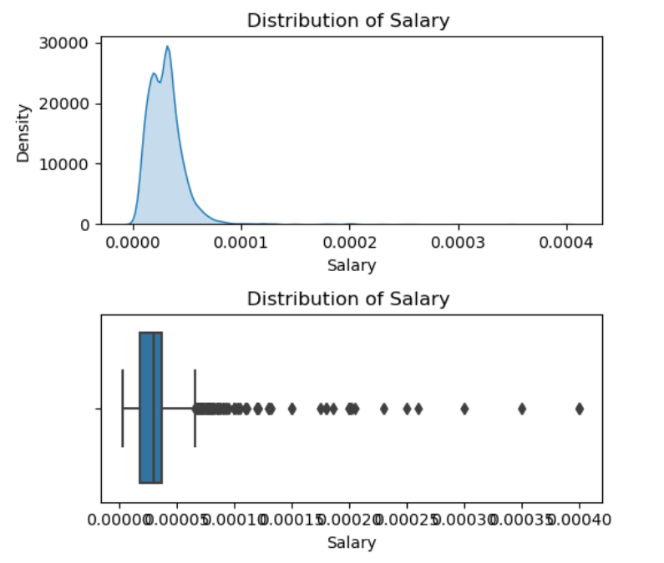
Univariate Analysis
Salary
The salary range spans from 0.35 lakh to 40 lakhs, with the majority of candidates (72%) earning between 1 and 4 lakhs, and 99% earning less than 9.3 lakhs. Initially skewed to the right due to outliers, the distribution becomes more normal after their removal. Surprisingly, the distribution without outliers reveals a bimodal pattern, hinting at two distinct salary groups within the dataset..

Slide 8
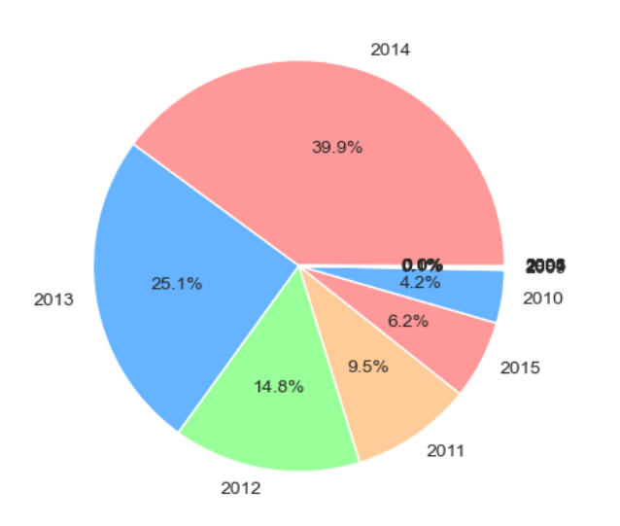
Univariate Analysis
DOB
39.9% of students joined were born in 2014

Slide 9
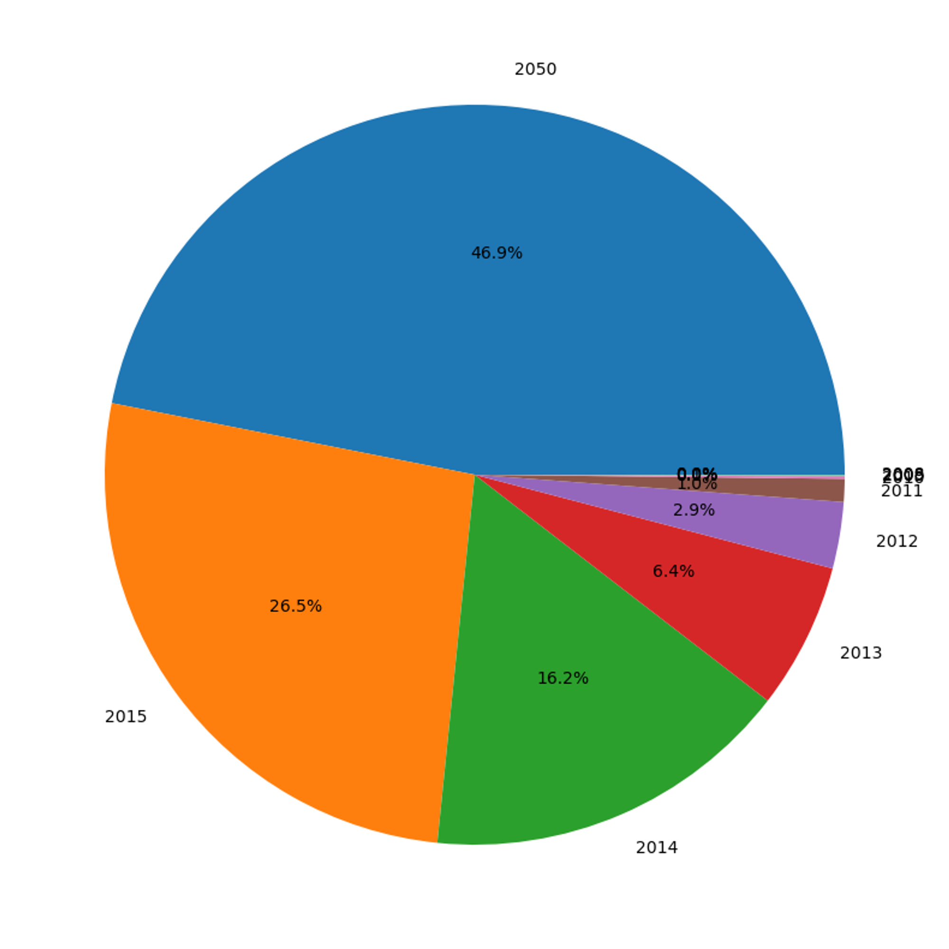
Univariate Analysis
DOL
46.9% of candidates assumed to be still working in their companies
- 26.5% candidates left company in 2015

Slide 10
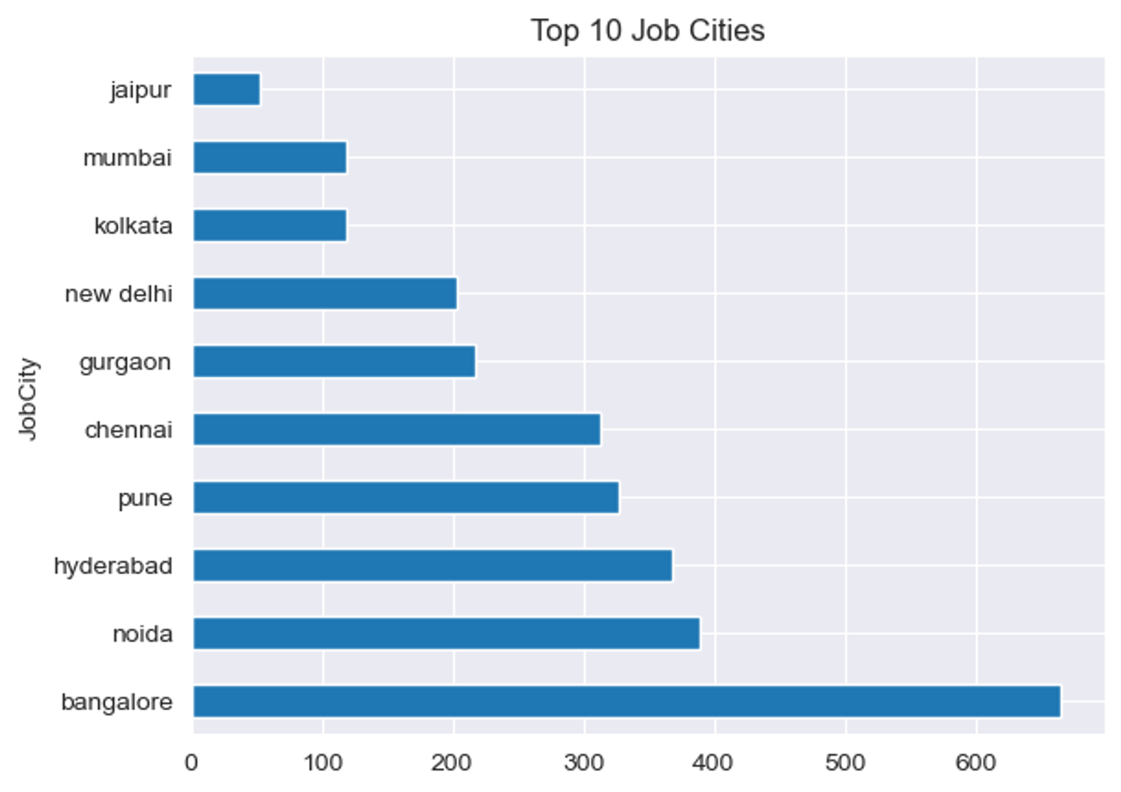
Univariate Analysis
JobCity
69.4% of candidates work in top 10 cities
Banglore is the most popular career destination for candidates

Slide 11
Univariate Analysis
JobCity
69.4% of candidates work in top 10 cities
Banglore is the most popular career destination for candidates

Slide 12
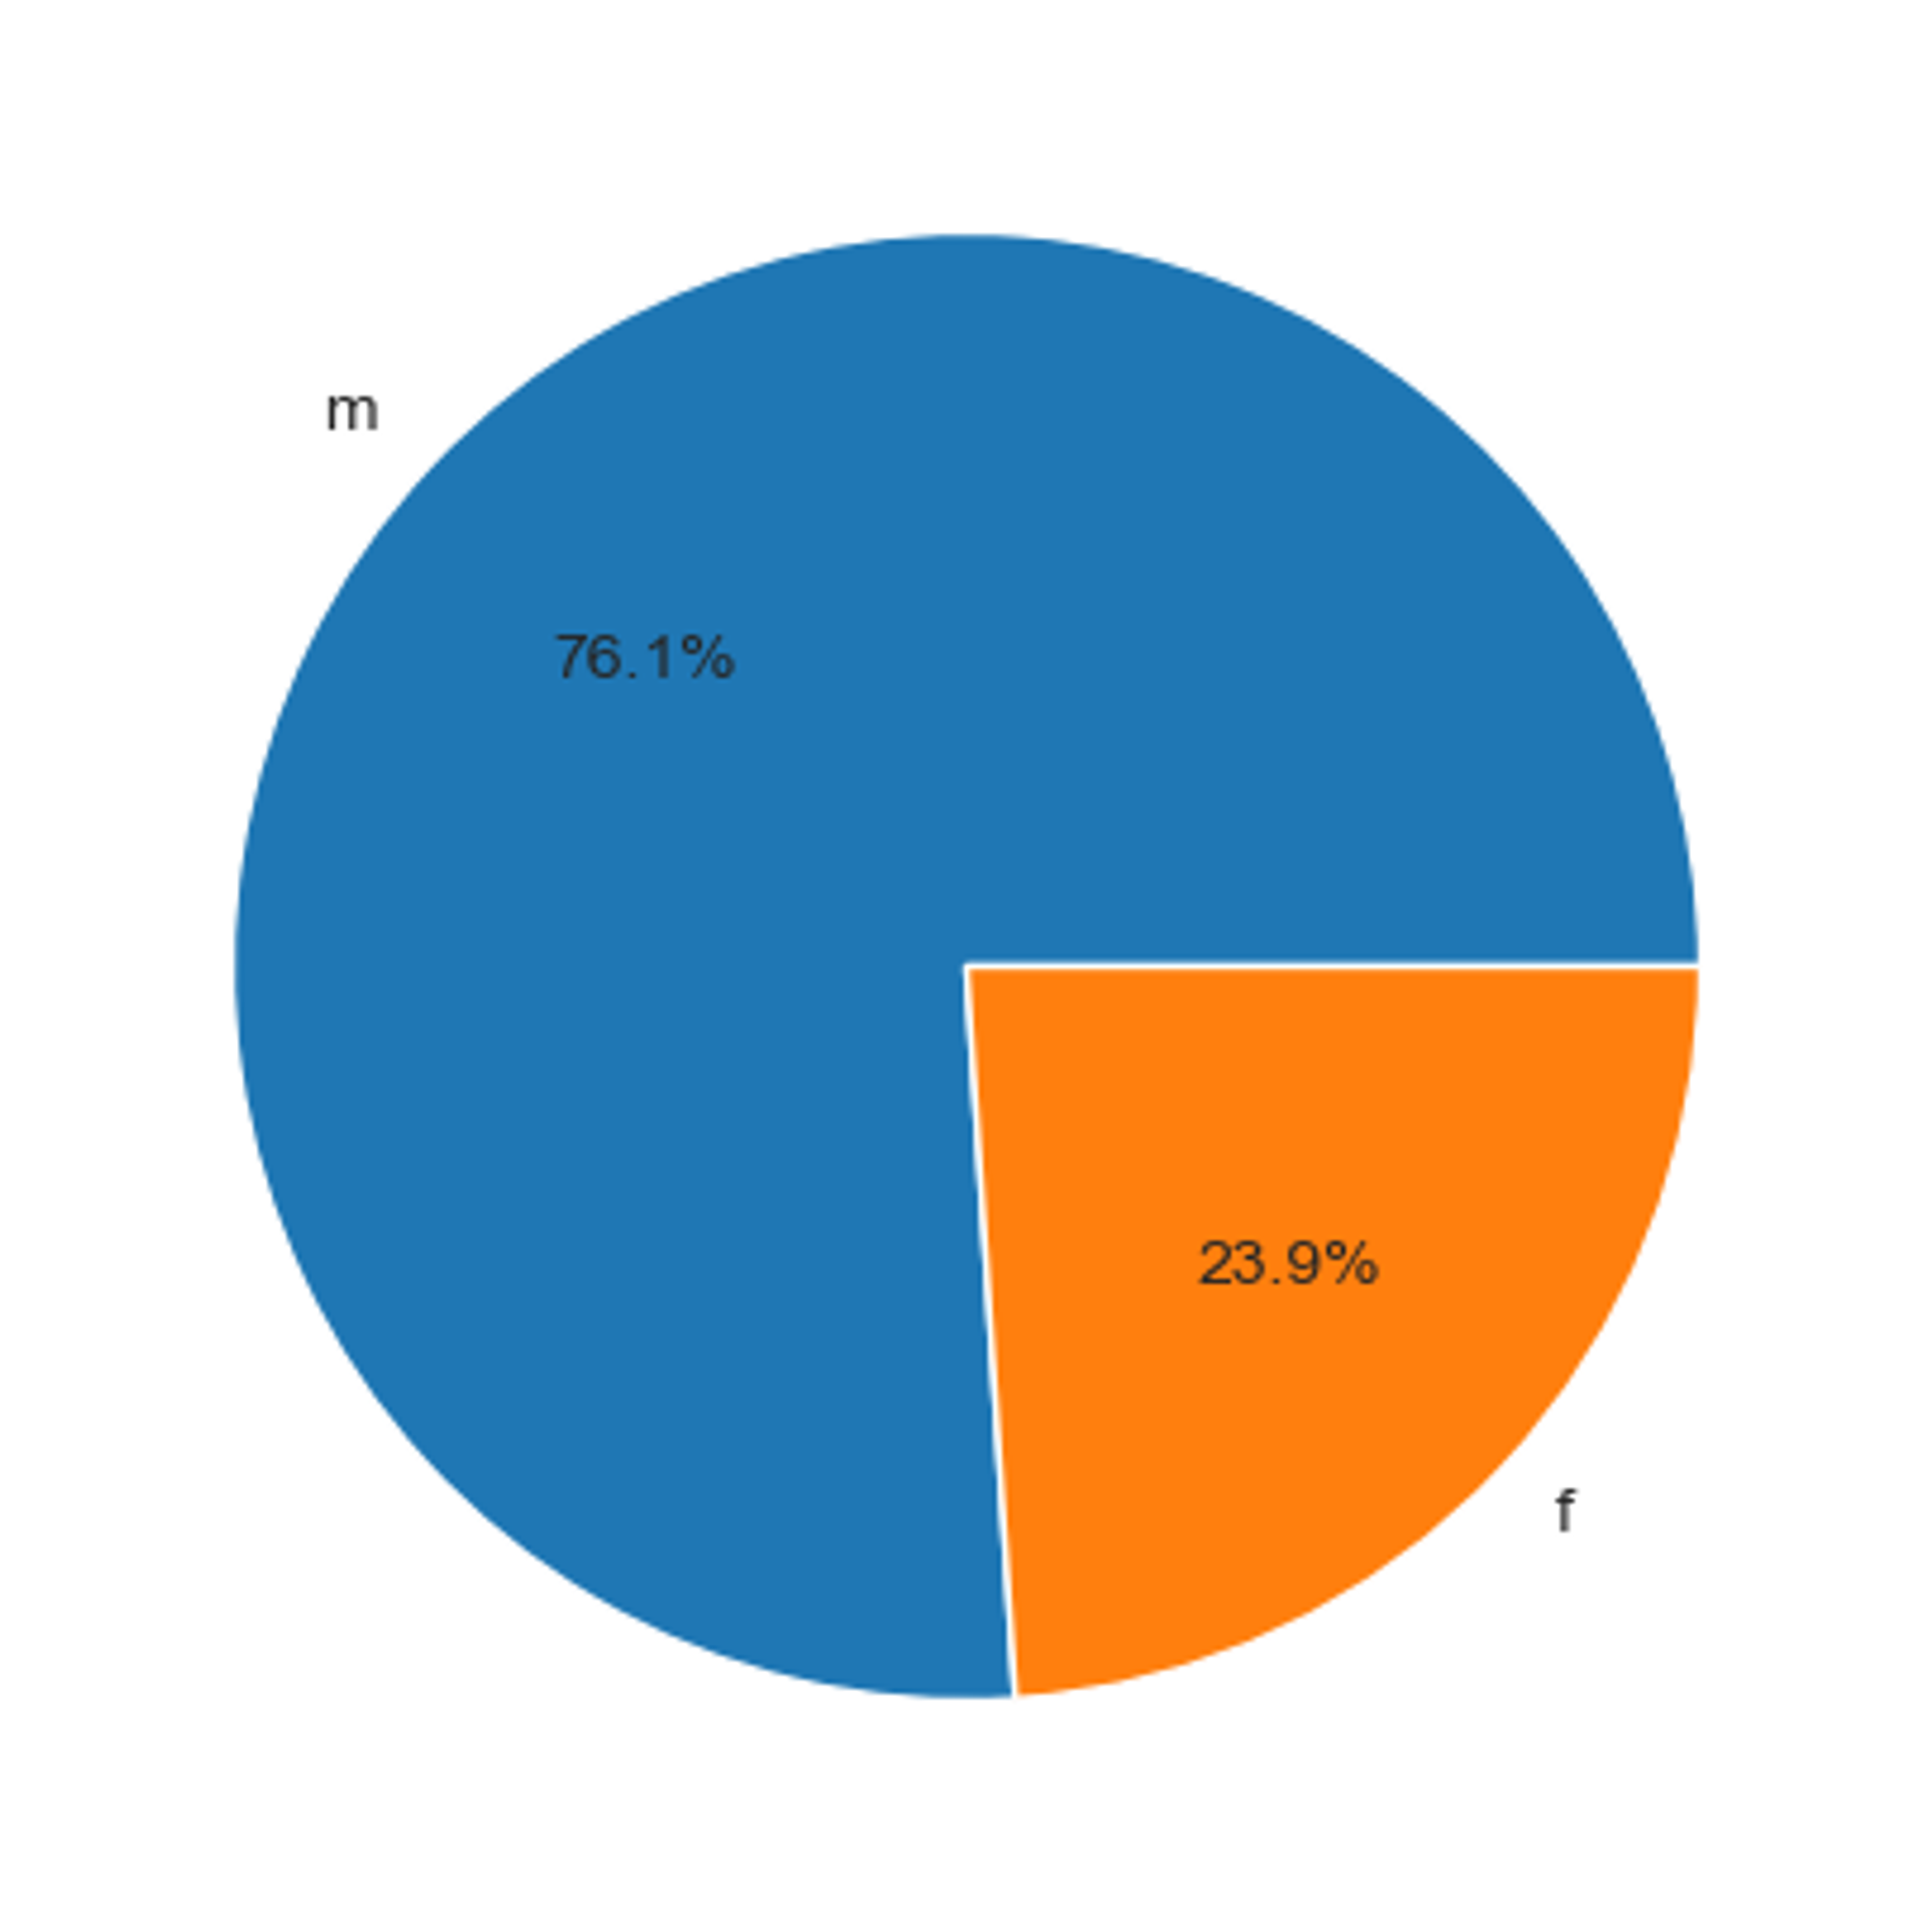
Univariate Analysis
Gender
76.1% of candidates are male
23.9% candidates are female

Slide 13
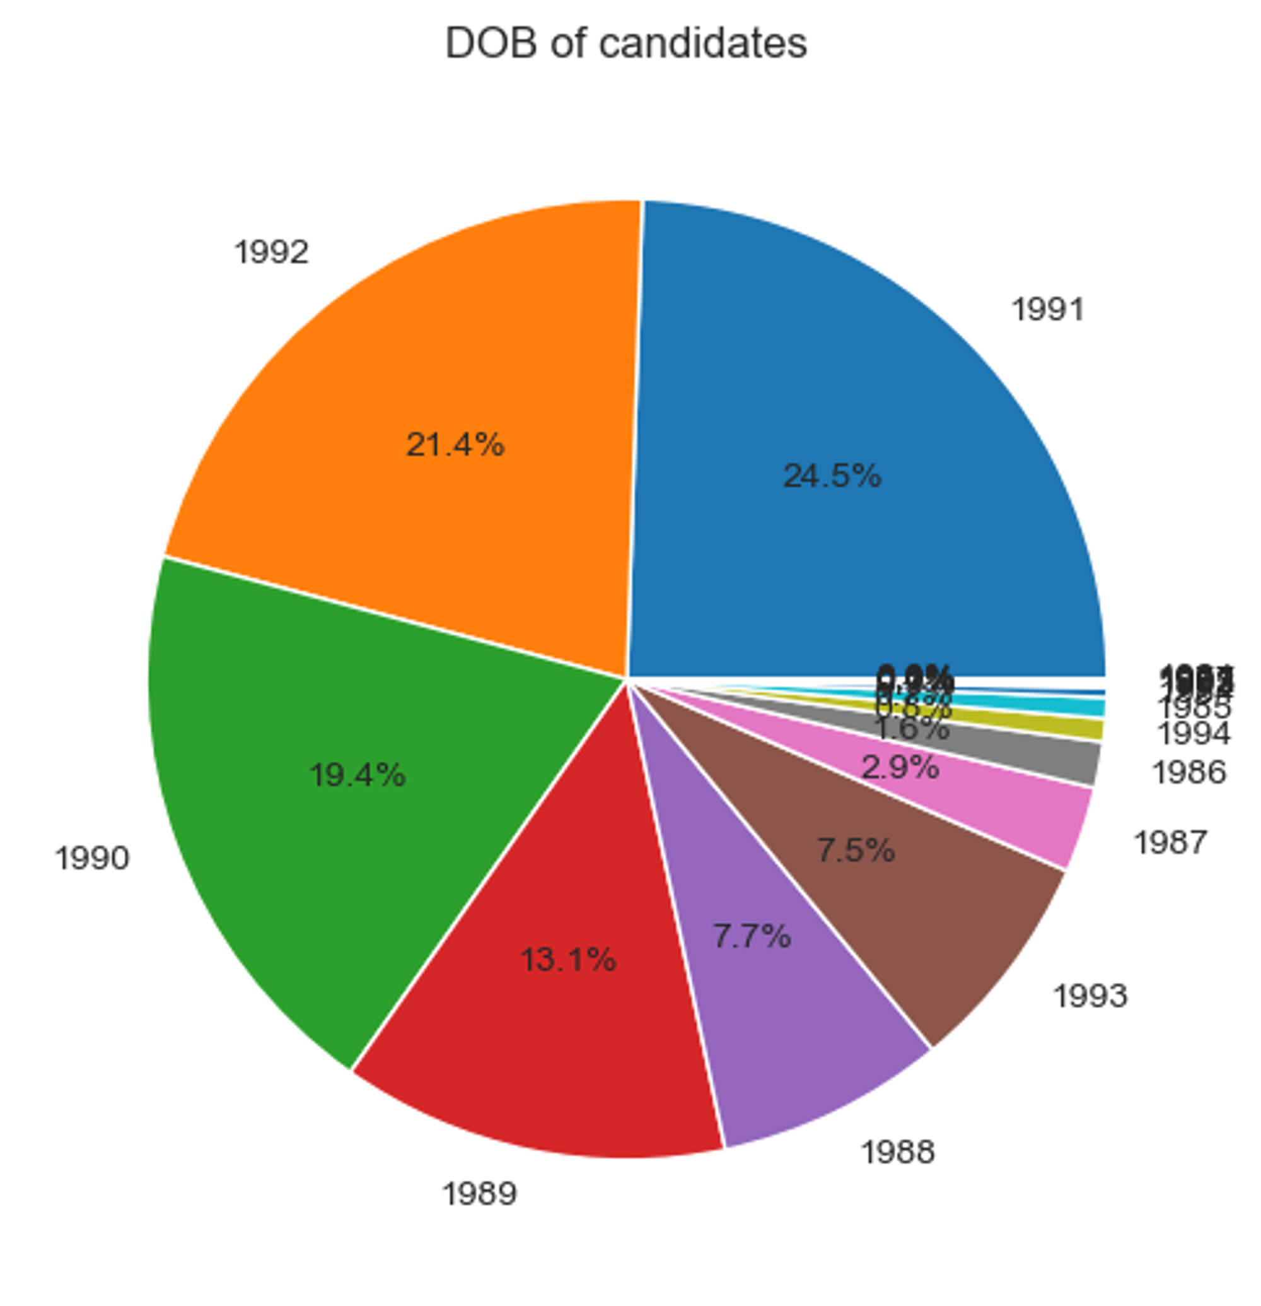
Univariate Analysis
DOB
65.3 % of candidates were born between 1990 and 1991

Slide 14
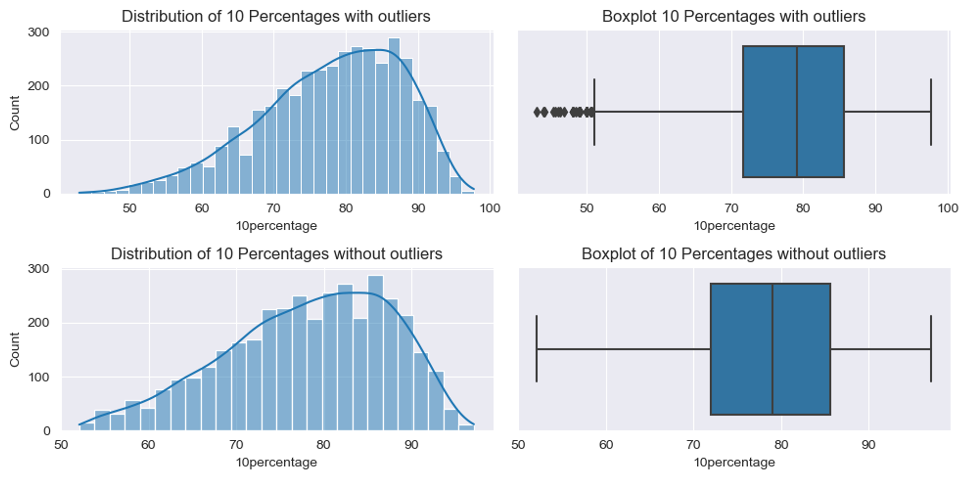
Univariate Analysis
10th Percentage
Minimum percentage is 43% and max is 97.7%
% are left skewed, means most candidates scored more than 60

Slide 15
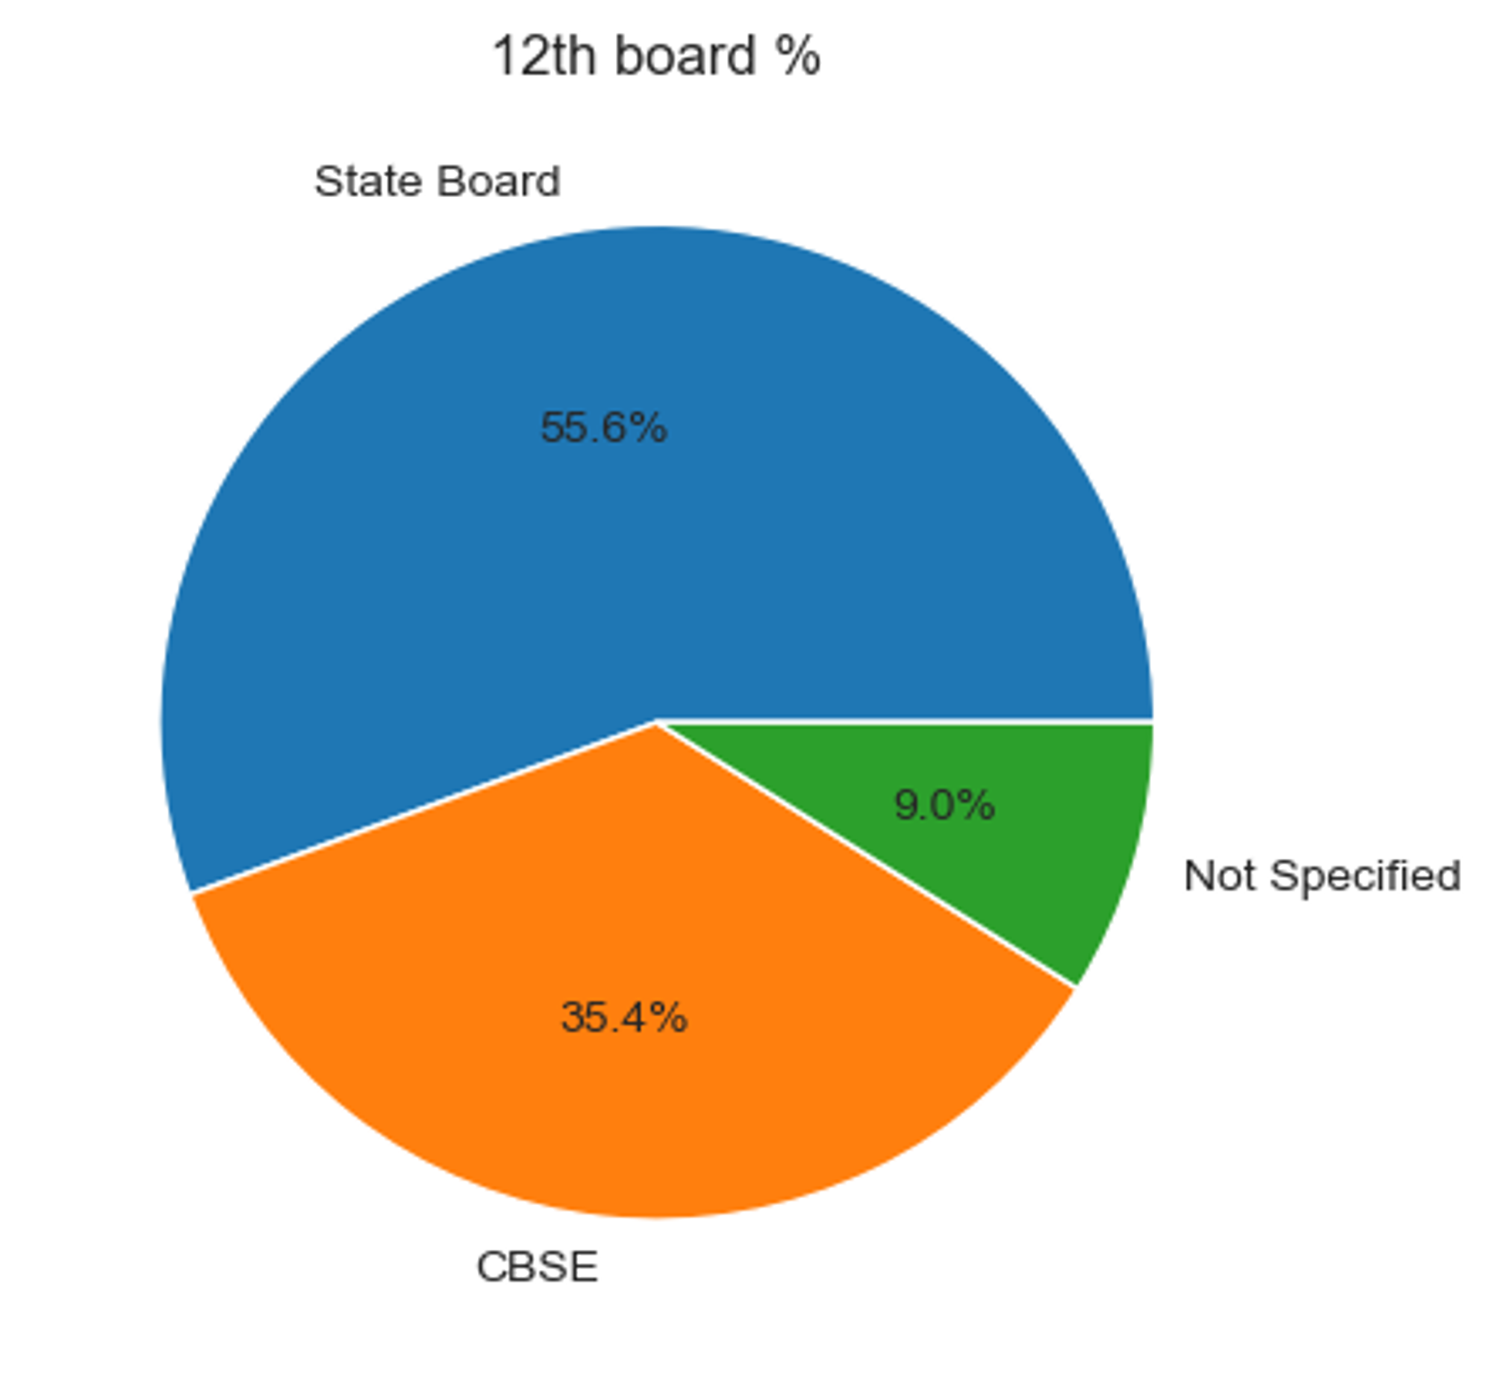
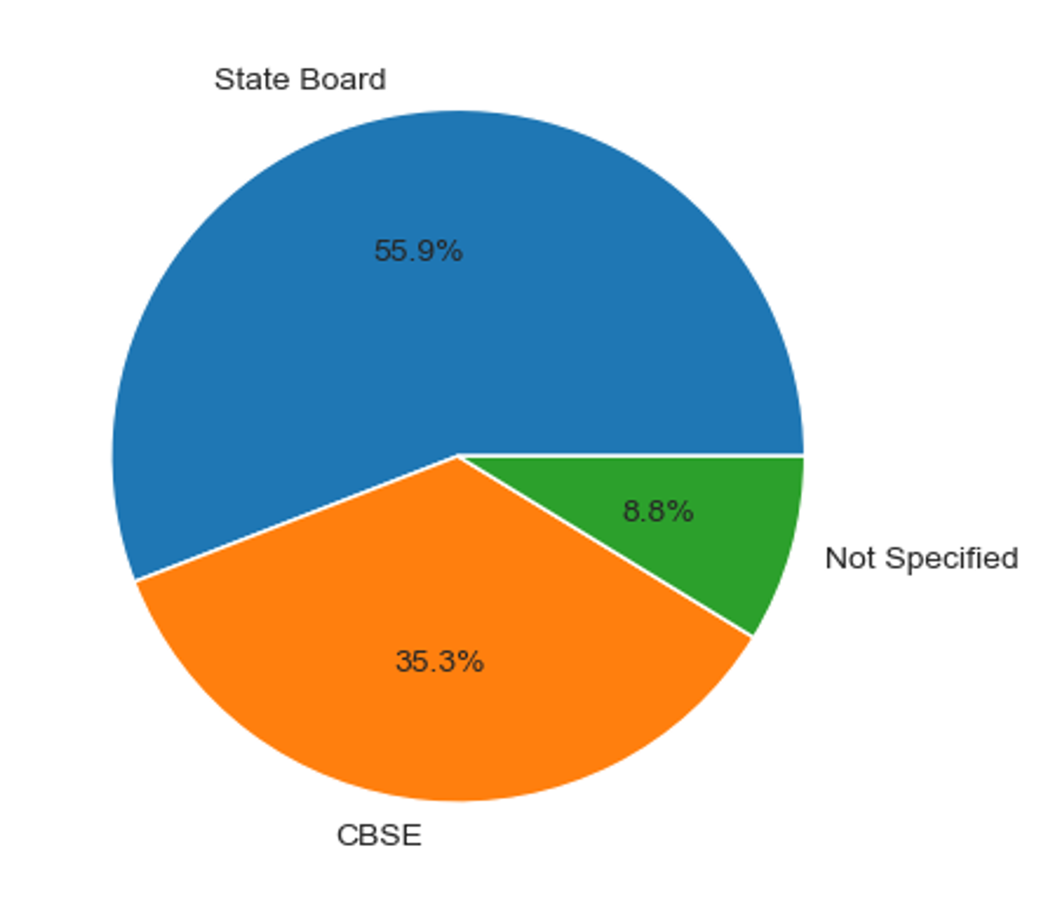
Univariate Analysis
10th,12th Board

Slide 16
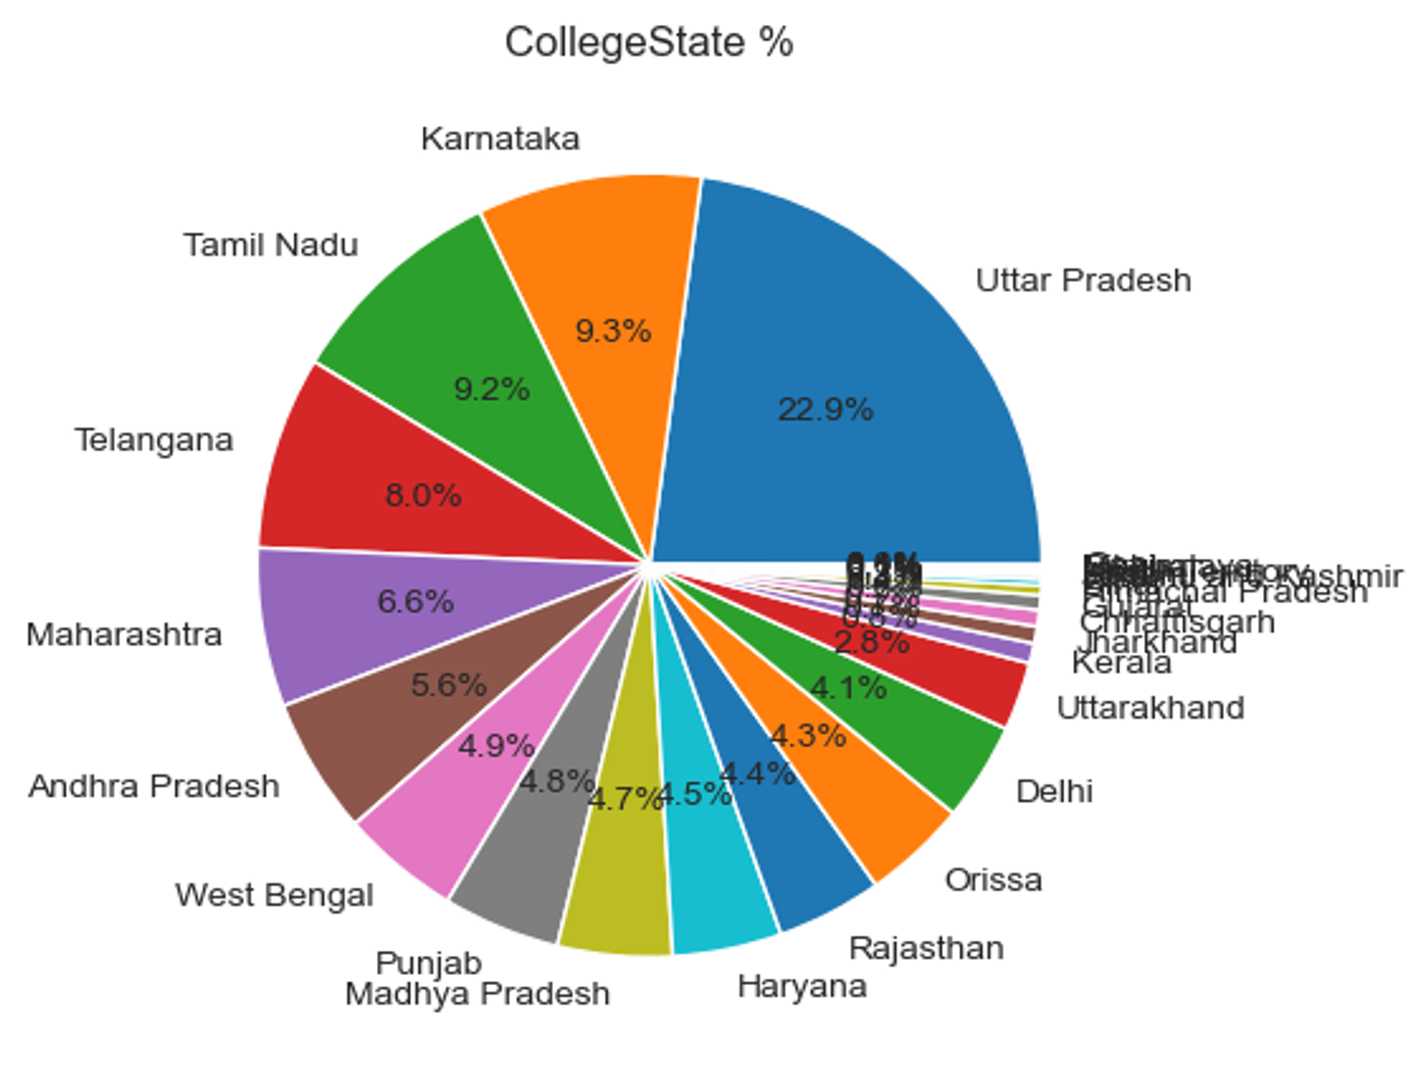
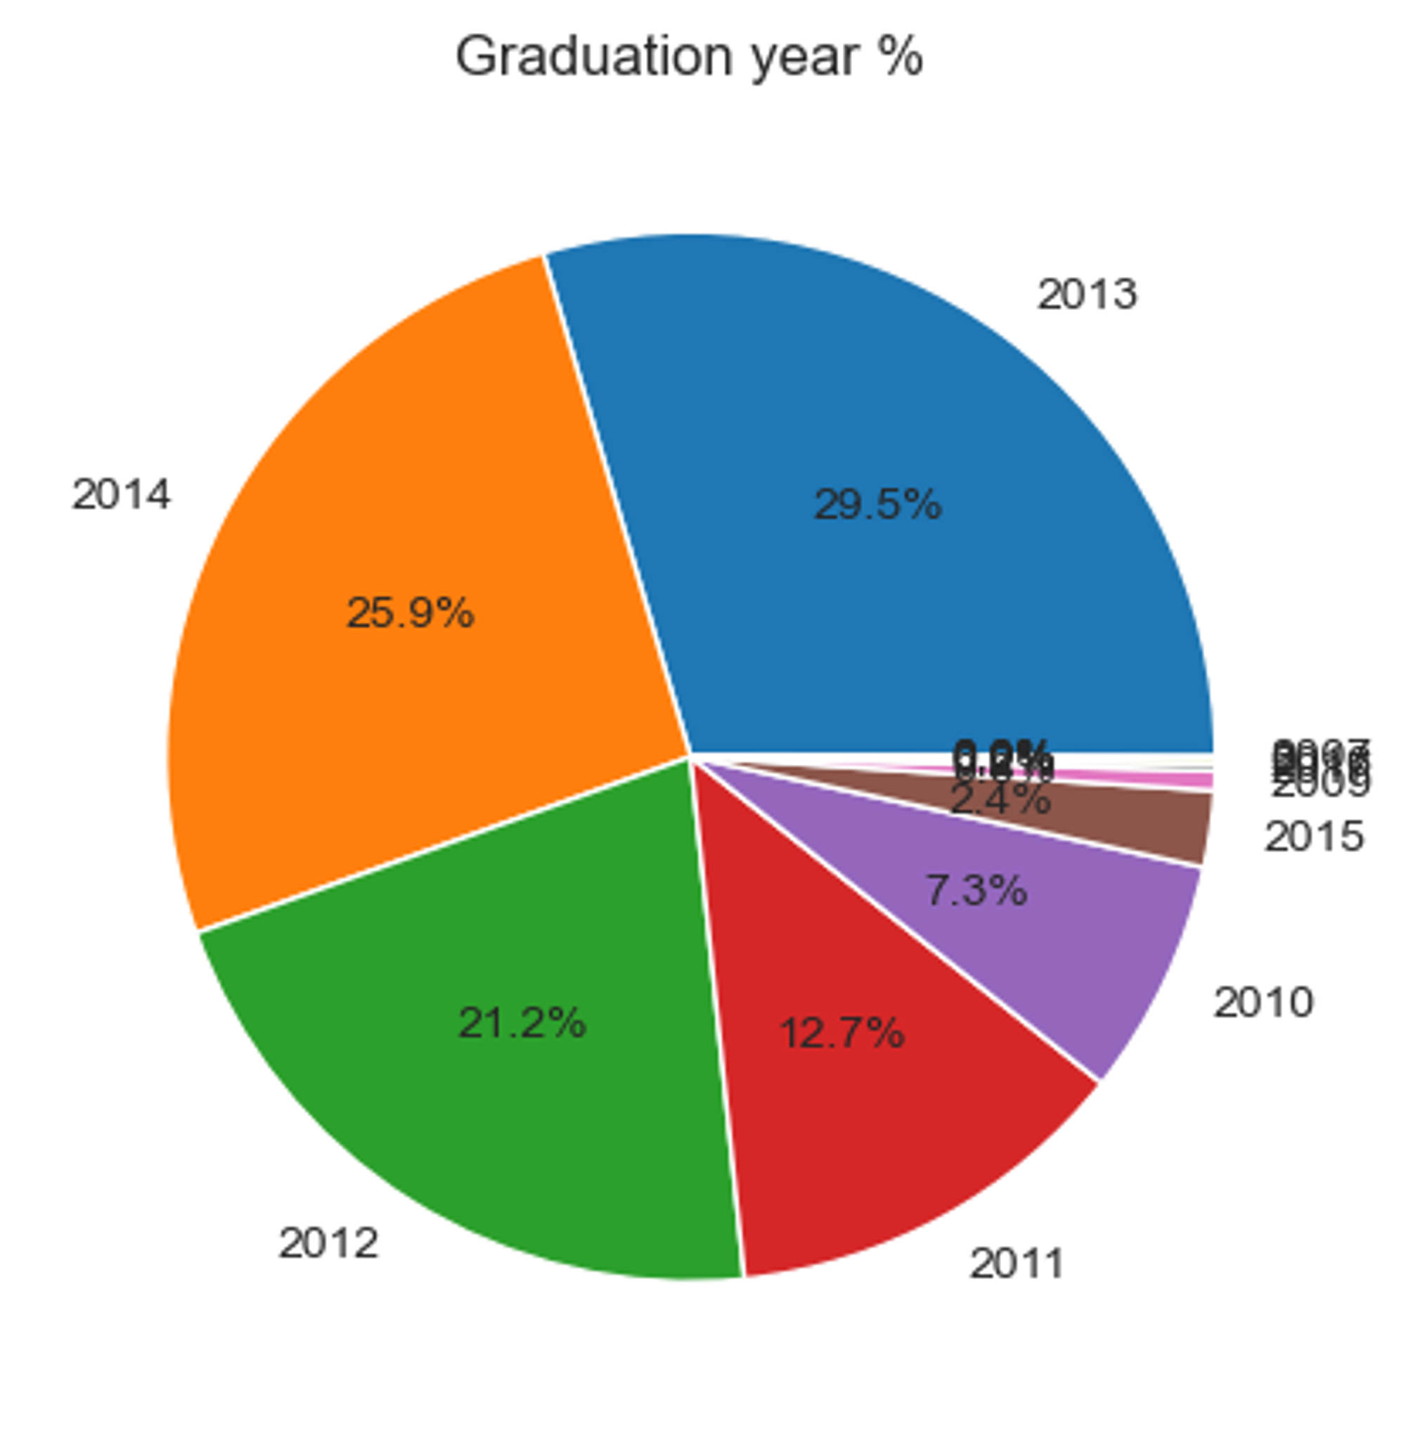
Univariate Analysis
CollegeState%, GraduationYear%

Slide 17
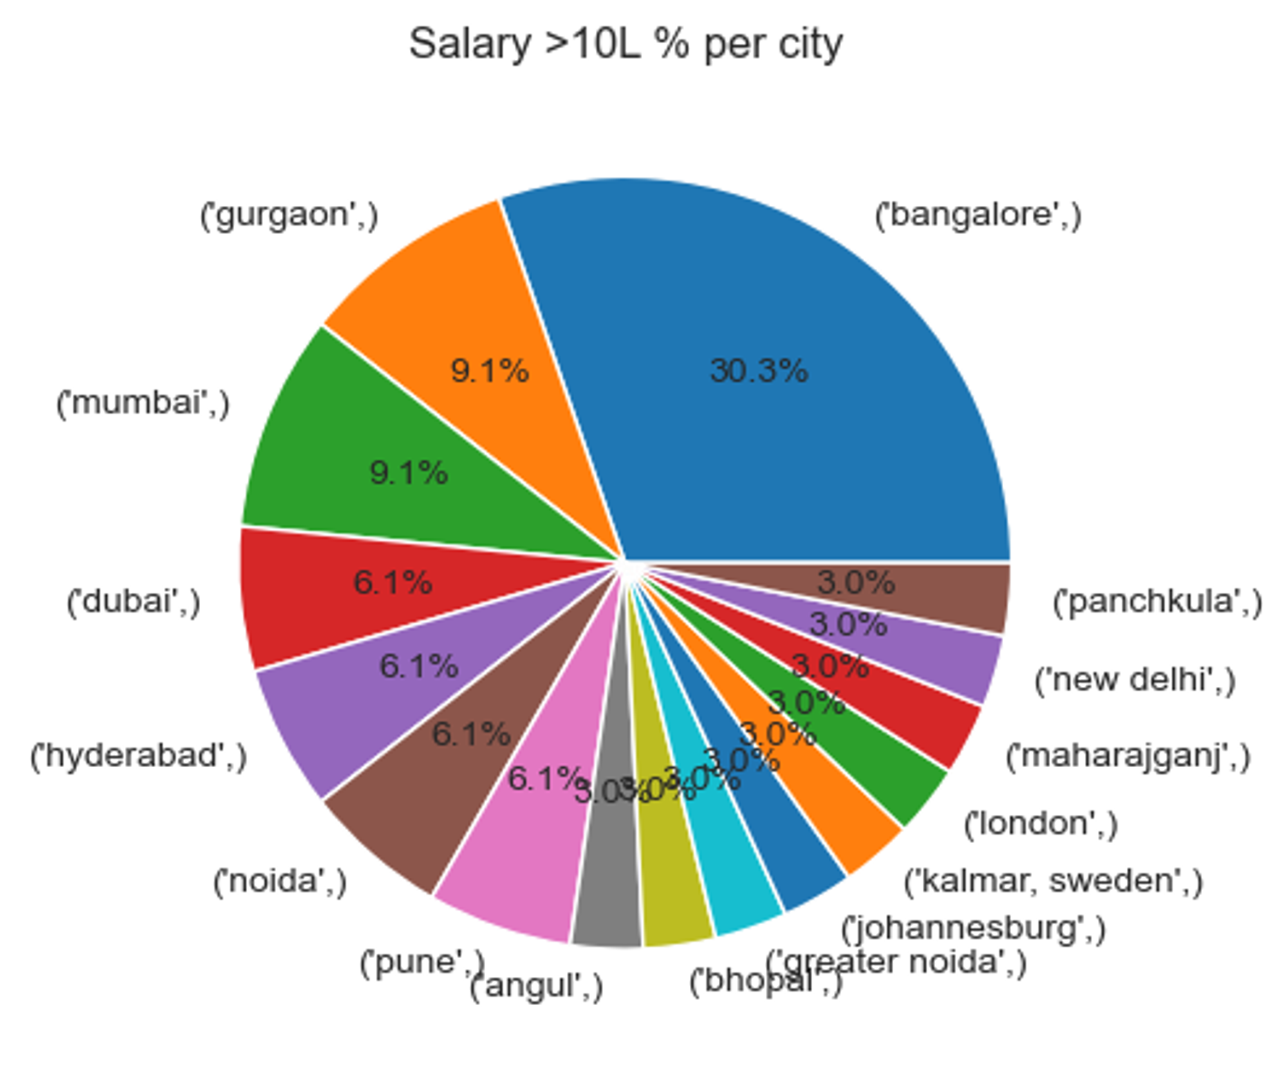
Bivariate Analysis
In which cities most highest packages greater than 10 are offered?
30.3% of Compensations >10 Lakhs are from Bangalore based companies.

Slide 18
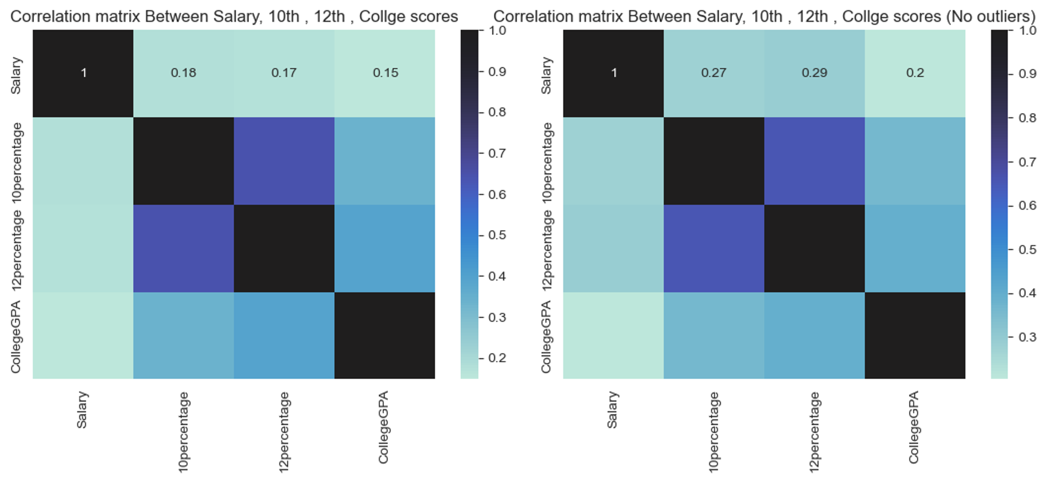
Bivariate Analysis
Is there a concrete correlation between Salary offered to a candidate and their academic scores?
There is no significant relationship between salary and other scores

Slide 19
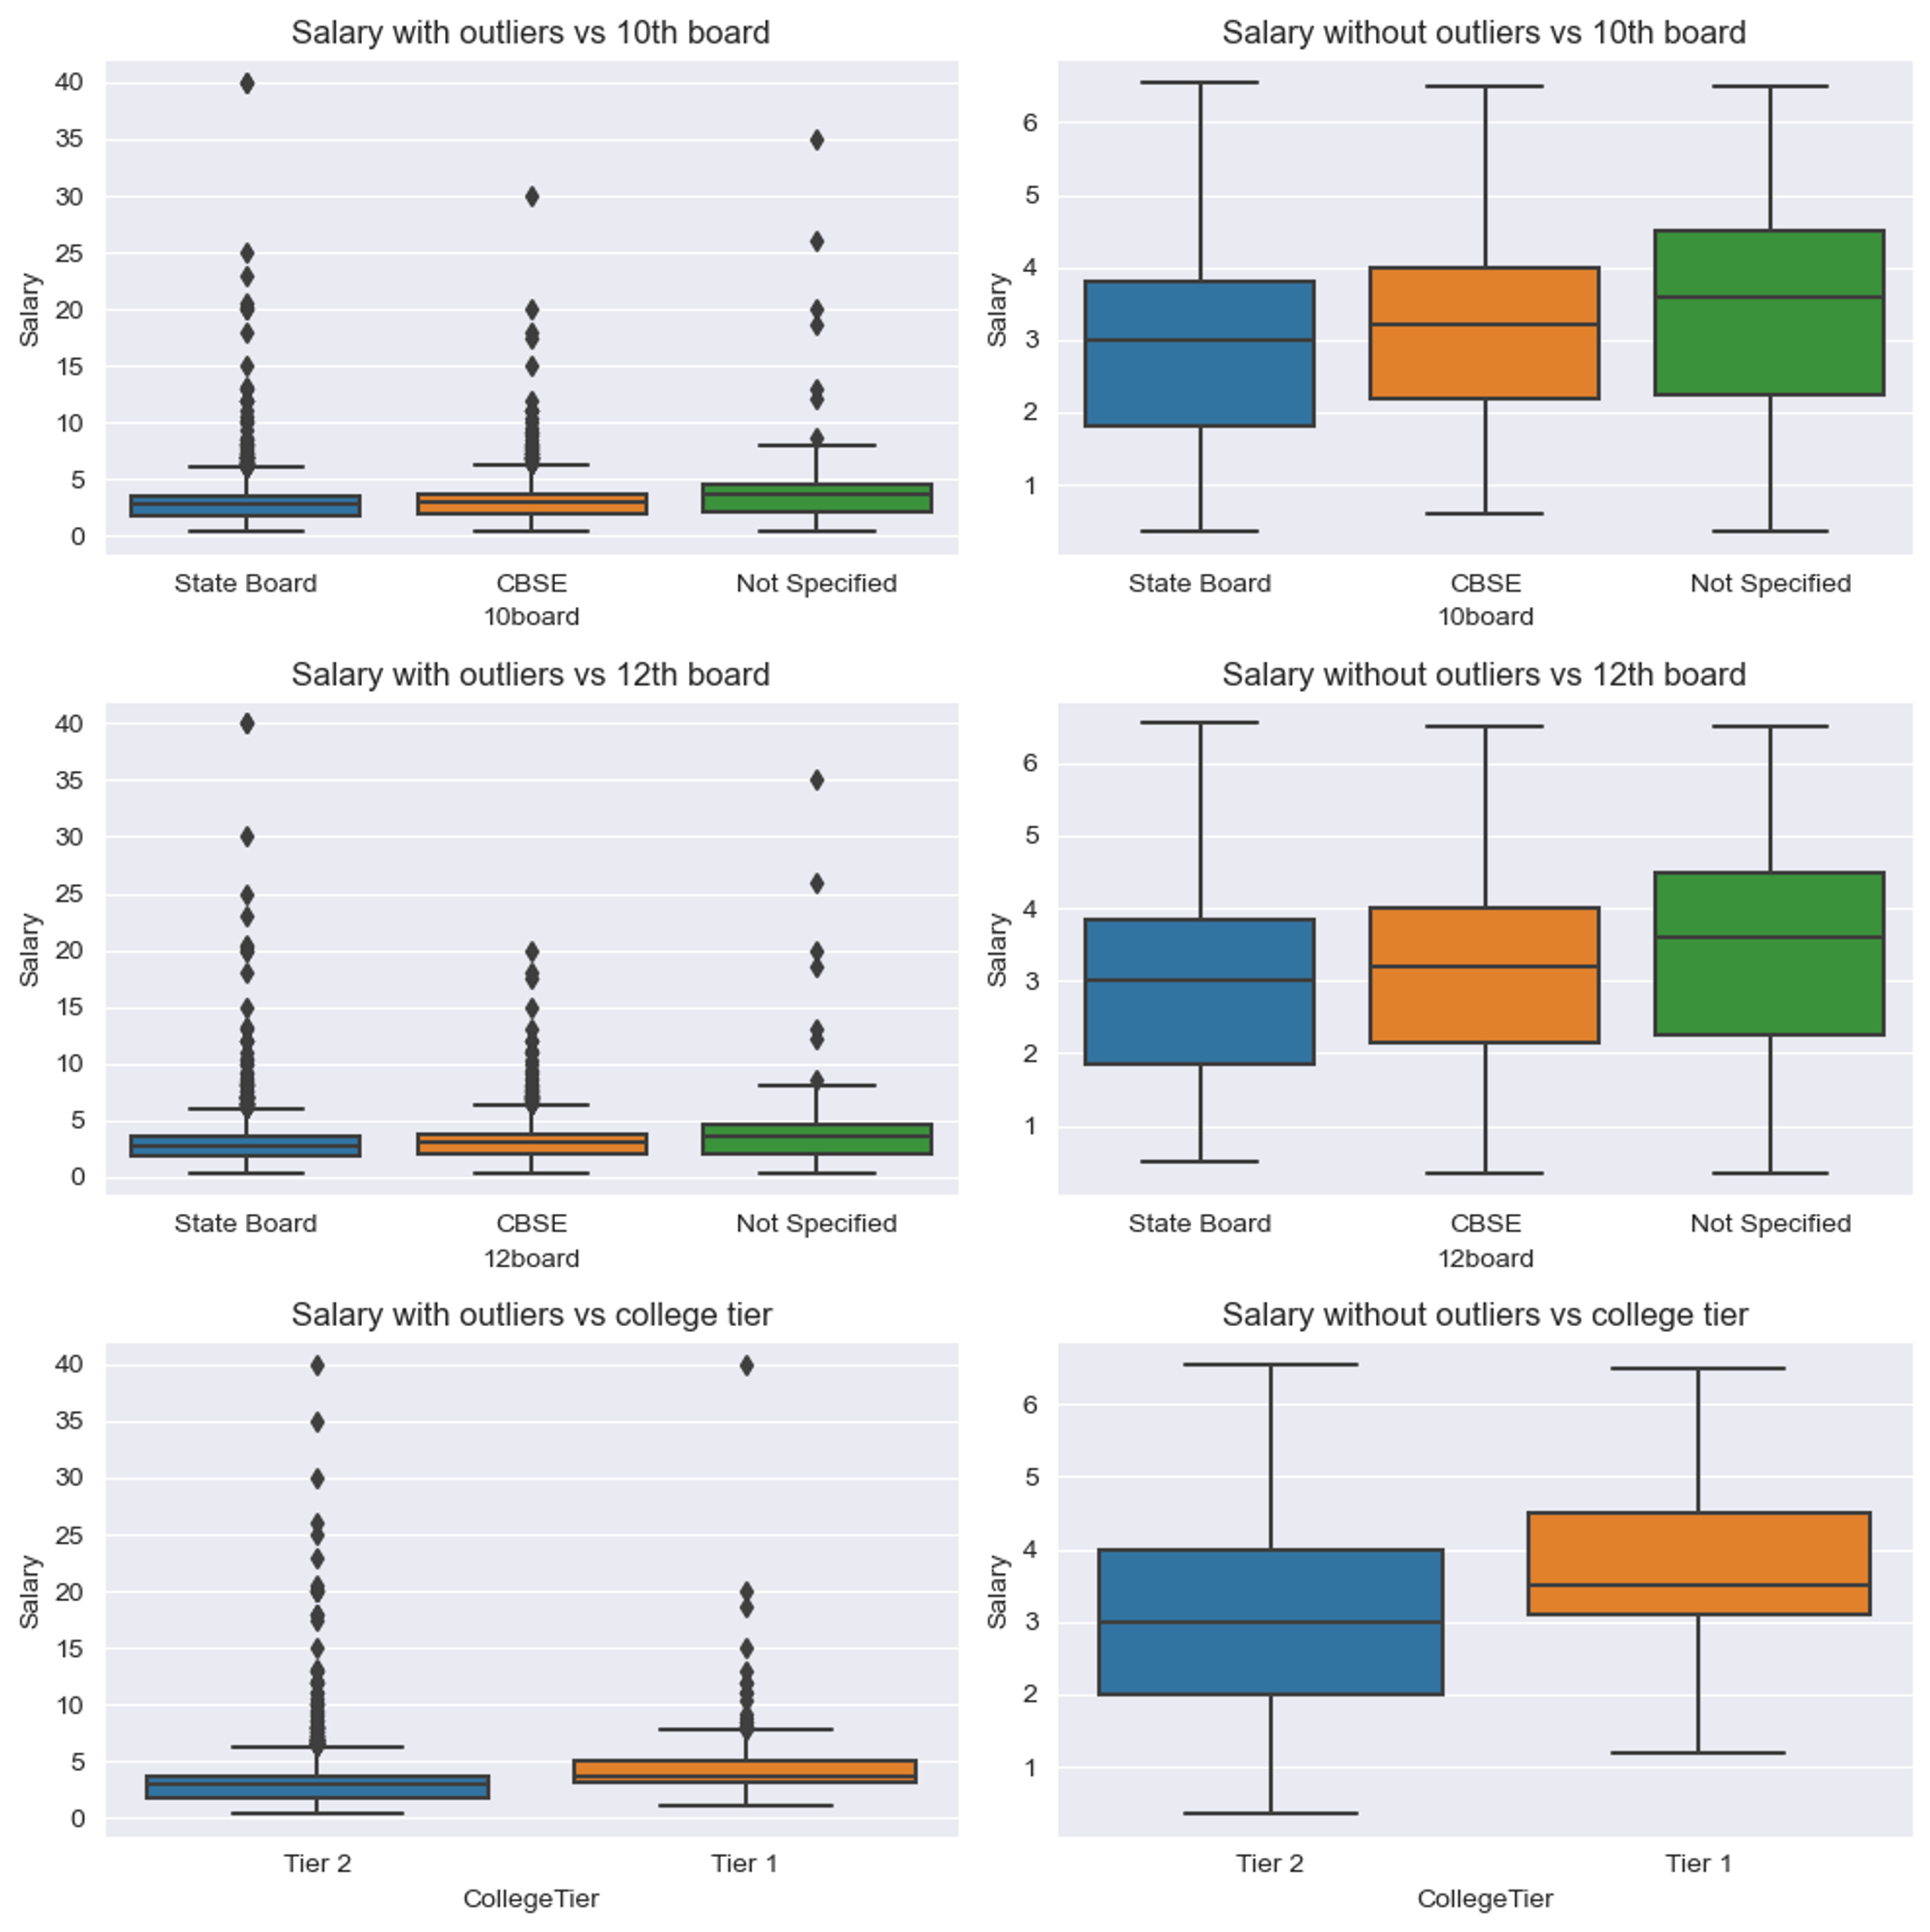
Bivariate Analysis
Is there a concrete correlation between Salary of the candidates and the type of educational institutes they attended?
Candidates who studied in CBSE board
and also in Tier 1 college tend to
get a better median salary

Slide 20
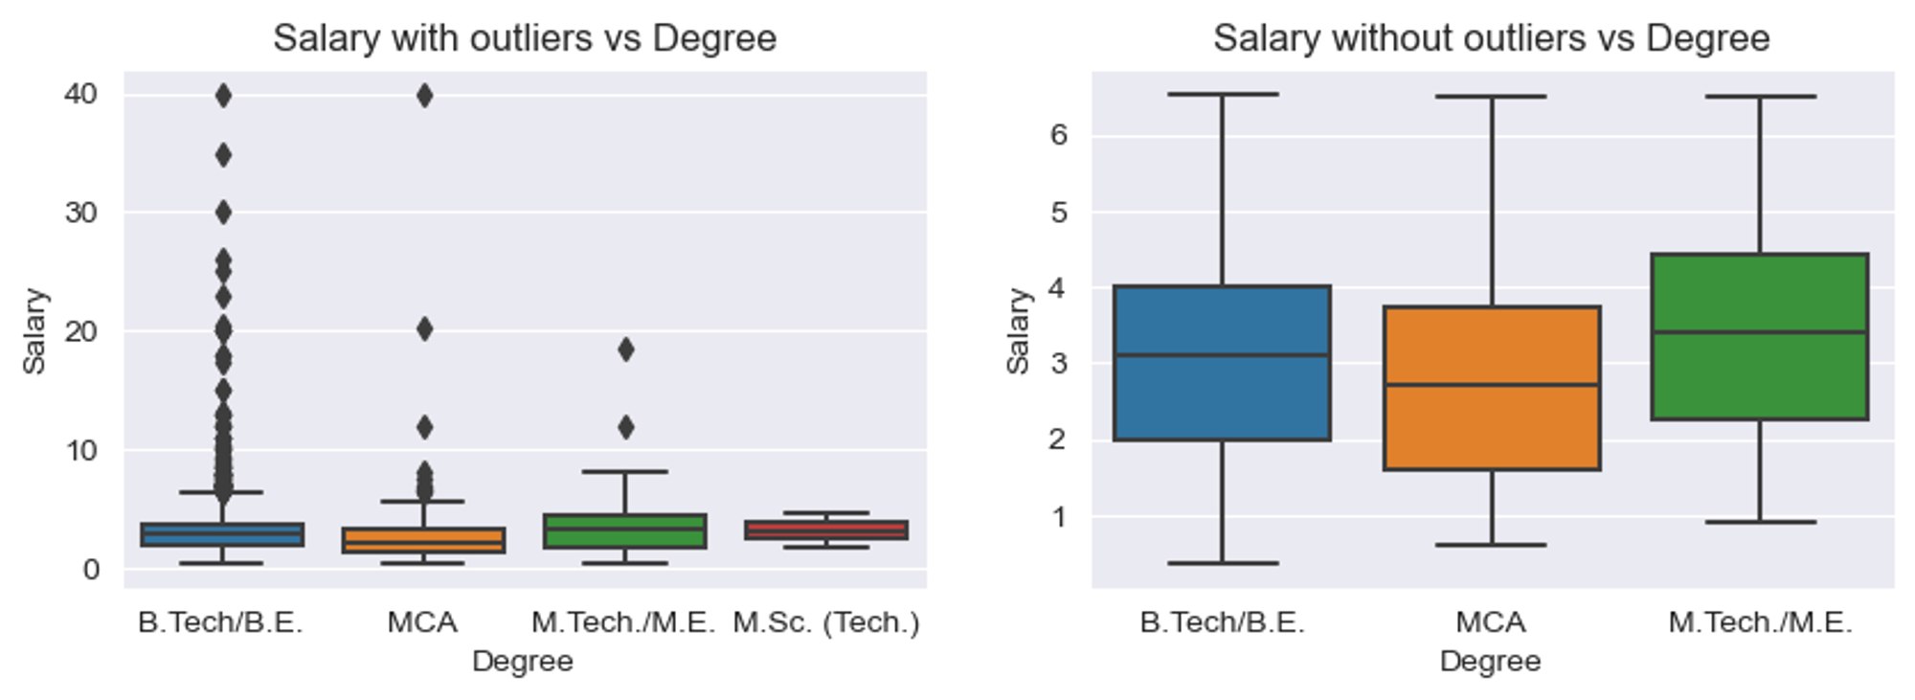
Bivariate Analysis
Is there any relation between Degree of Candidates and their Salaries?
The density of outliers is more in B.Tech/BE degree than M.Tech/ME. Hence, higher packages are more likely be secured by studying B.Tech.
But when outliers are removed, M.Tech offers better median package than even MCA.

Slide 21
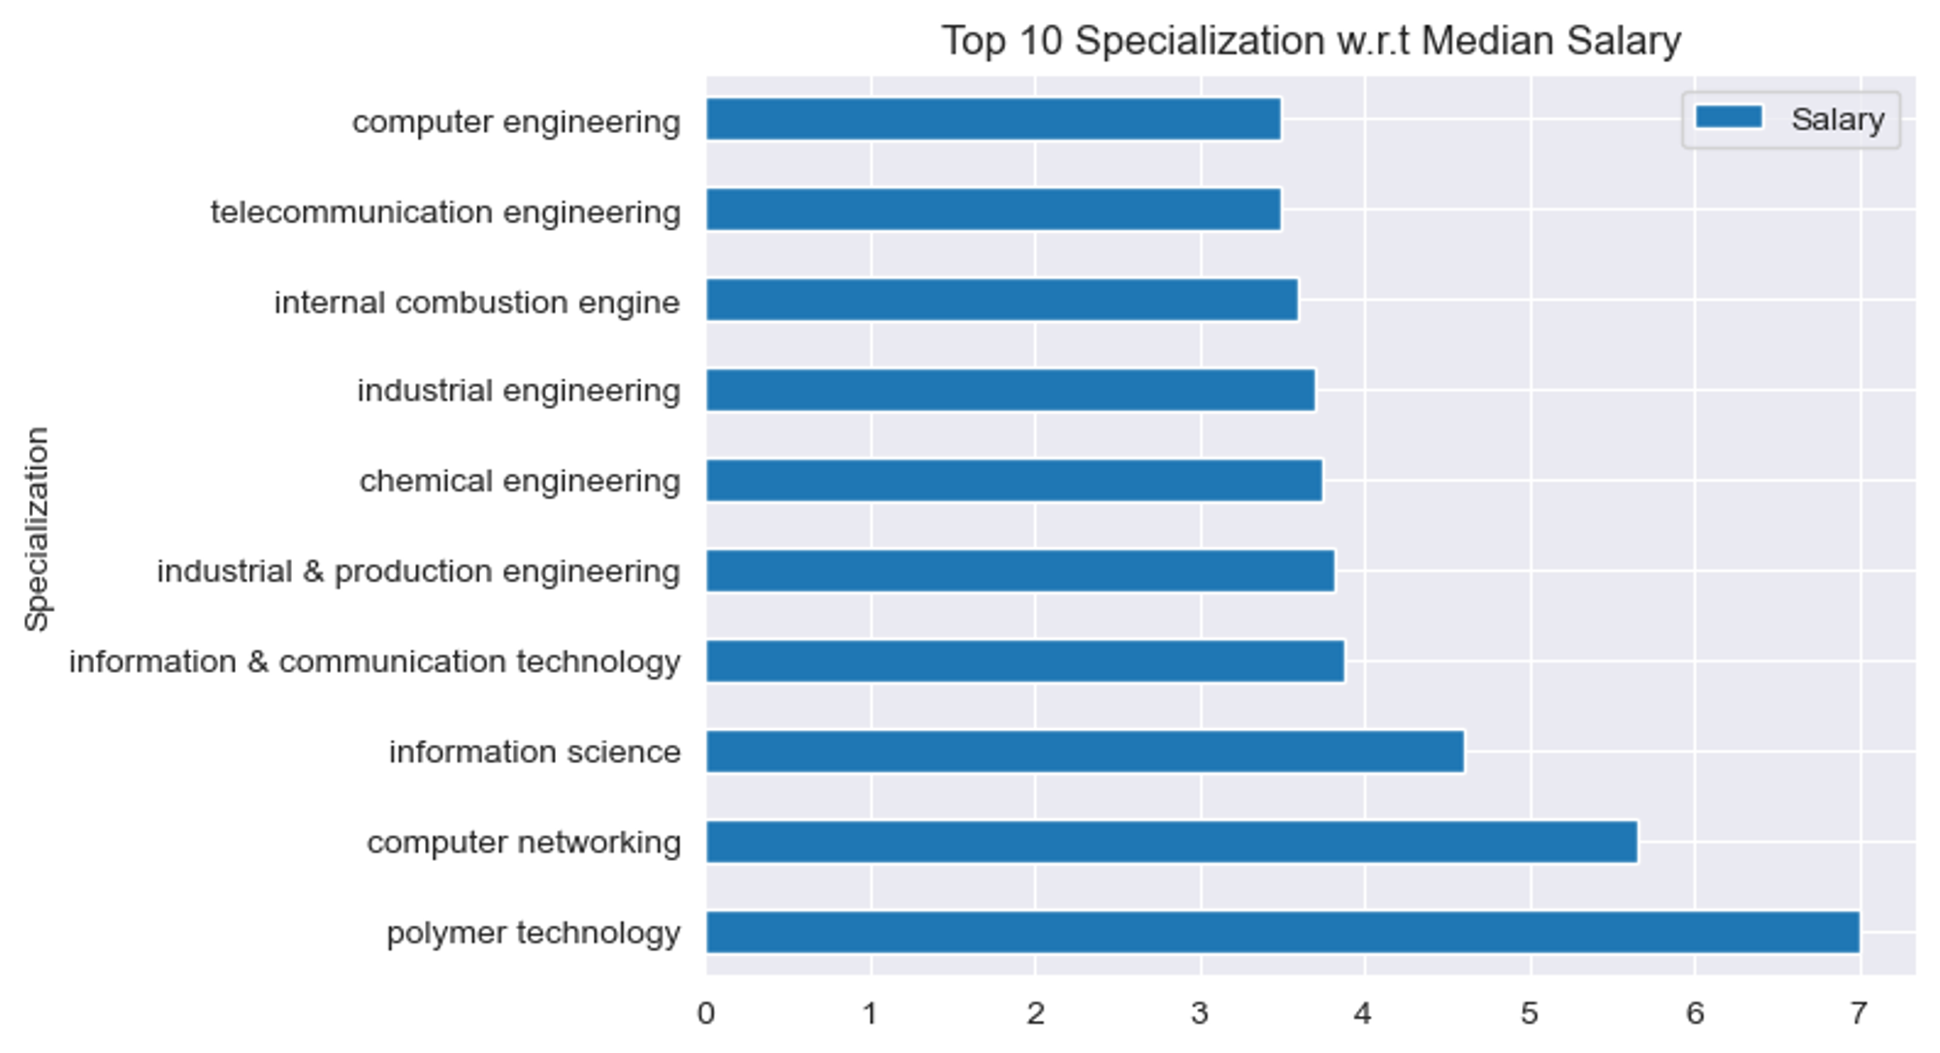
Bivariate Analysis
Specialization vs Median Salary
Polymer Technology specialization is offering maximum Median salary..

Slide 22
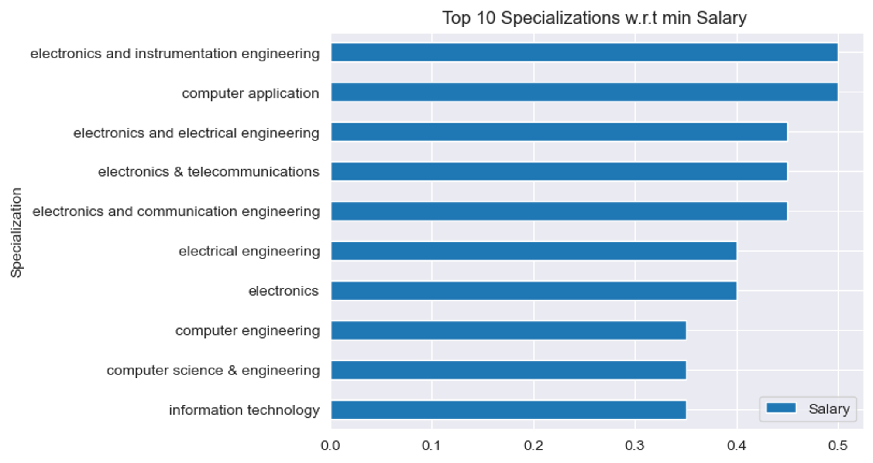
Bivariate Analysis
Specialization vs Minimum Salary
Min Salary is offered by Information Technology Specialization

Slide 23
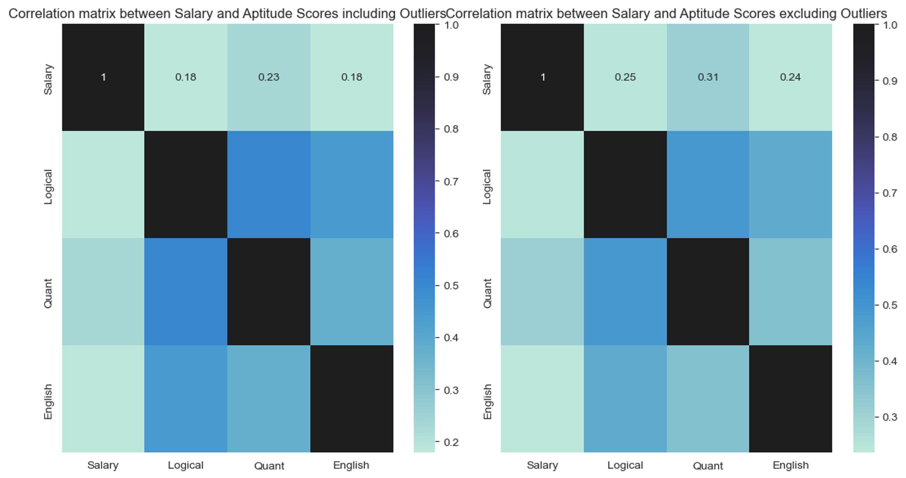
Bivariate Analysis
Is there a strong relation between Aptitude Scores and Salary?
Overall, ther is not much correlation between Aptitude scores and Salary.
But among them, Quantitative Reasoning has strong correlation with Salary.

Slide 24
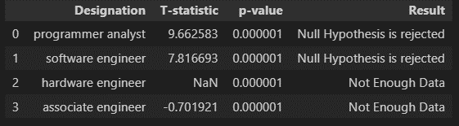
Research Outcomes
Times of India article dated Jan 18, 2019 states that “After doing your Computer Science Engineering if you take up jobs as a Programming Analyst, Software Engineer, Hardware Engineer and Associate Engineer you can earn up to 2.5-3 lakhs as a fresh graduate.” Test this claim with the data given to you.
For Programmer analyst and Software Engineer Specializations, the mean salary is not 2.75 Lakhs as mentioned in the news article
For Hardware Engineer and Associate Engineer, there is not enough data to perform a accurate Hypothesis testing

Slide 25
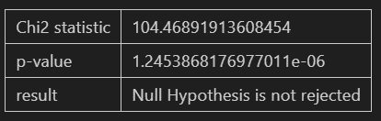
Research Outcomes
Is there a relationship between gender and specialization? (i.e. Does the preference of Specialisation depend on the Gender?)
As p-val is less than 0.05. We reject null hypothesis, thus there exist significant relation ship between specialization and gender

Slide 26
Conclusions
Approximately 30.3% of salaries exceeding 10 LPA are offered by companies located in Bangalore.
There is no significant correlation between academic scores in 10th, 12th, and college and the compensation obtained by candidates, even for those securing compensations exceeding 10 LPA.
However, attending a CBSE school and a Tier 1 college increases the likelihood of securing a higher median salary compared to other candidates.
The median salary for graduates and postgraduates is similar, but B.Tech/BE graduates show a higher density of outliers (candidates earning more than 10 LPA).
Opting for specializations that are not oversaturated increases the likelihood of obtaining a higher median salary.
There is no strong correlation between aptitude scores, personality scores, and salaries..

Slide 27

THANK YOU

